Slide 1

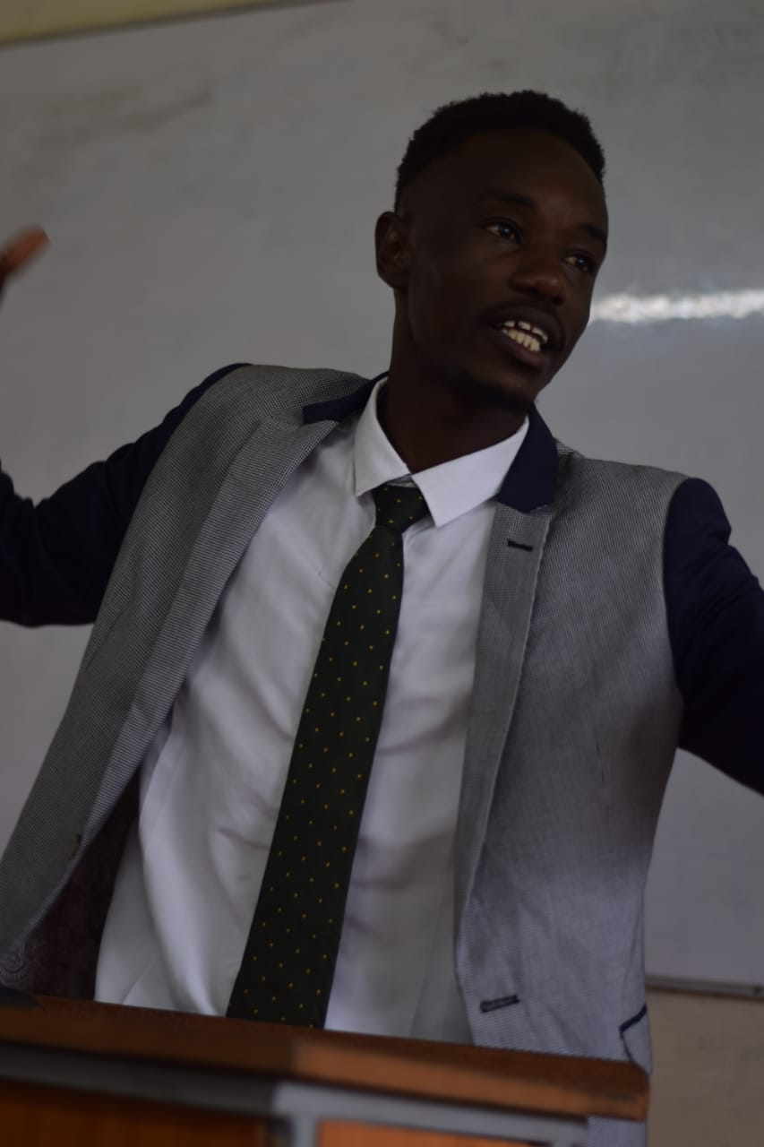
My Autobiography
I’m James Makomele, and I’m thrilled to share my life story with you. It’s a journey filled with ups and downs, lessons learned, and unforgettable moments.
by EBITONYI JAMES MAKOMELE

Slide 2


Born in Nairobi, Kenya
I was born into a loving family in the town of Nairobi, Kenya. It was a vibrant place filled with energy and a strong sense of community.
My Parents
My parents, Evalyne Okango and Musa Ebitonyi, have always been my pillars of support. They instilled in me the values of hard work, compassion, and education.
NakuruThe town was a beautiful blend of nature and urban life. It provided a safe and nurturing environment for my childhood.

Slide 3
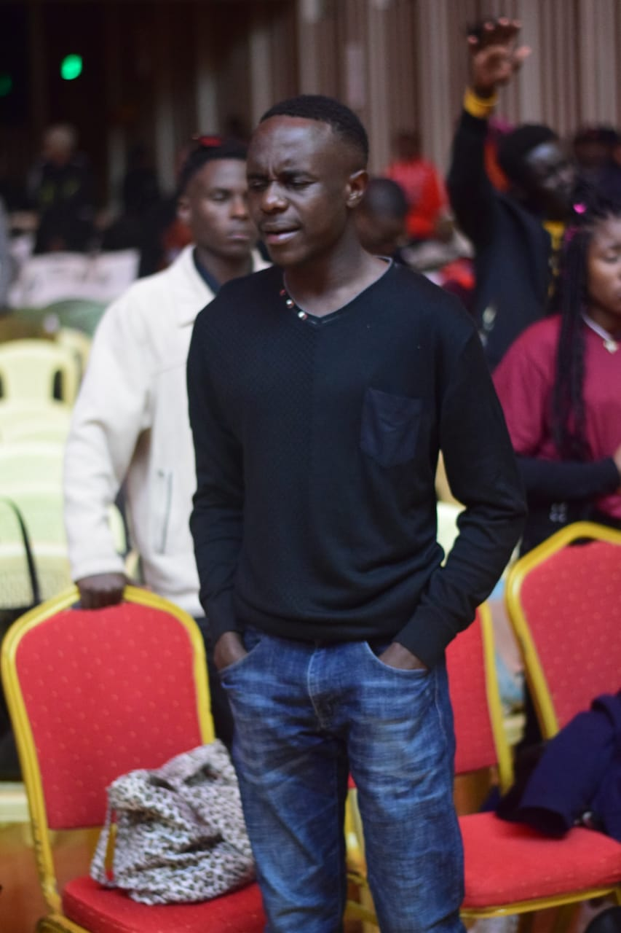
Loving Family with 6 Siblings
As the second born in a family of six—three boys and three girls—I’ve had the joy of growing up surrounded by siblings who are my lifelong friends.
1
Growing Up
My siblings and I shared countless memories, from playful afternoons in the backyard to lively family dinners filled with laughter and stories.
2
The Importance of Family
Growing up in a large family taught me the value of teamwork, compromise, and unconditional love.

Slide 4
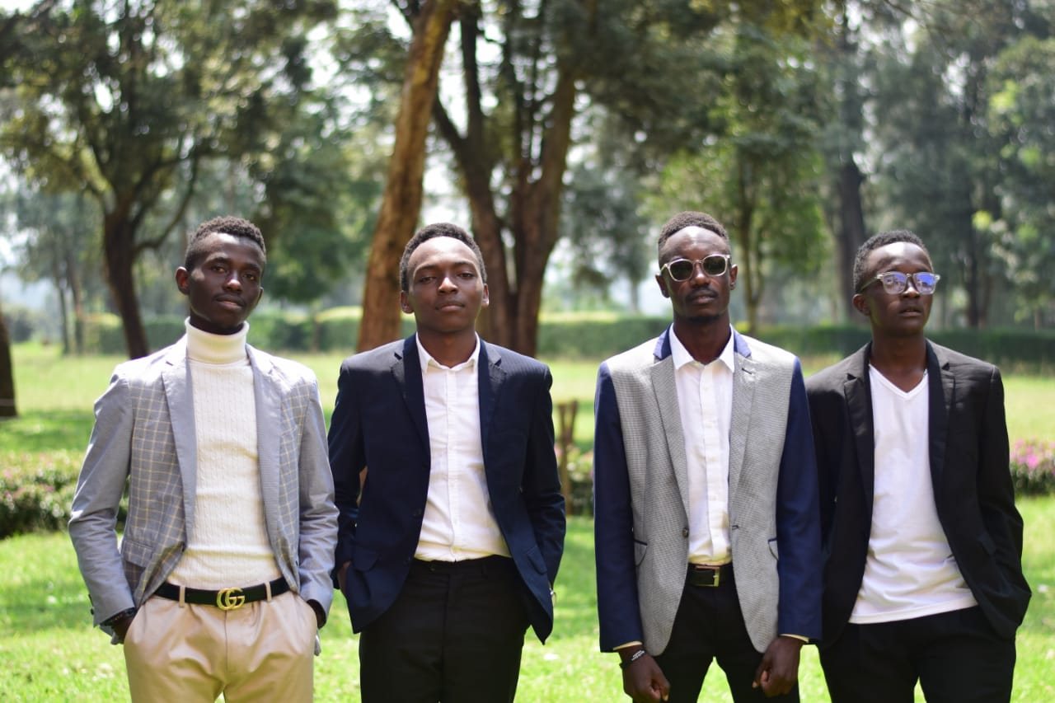
Lessons Learned and Challenges Faced
Life hasn’t always been easy. I've encountered challenges that tested my resilience and pushed me to grow. But, with each obstacle, I learned valuable lessons about life, perseverance, and the importance of never giving up.
1
Early Struggles
I faced financial difficulties, which instilled in me the importance of resourcefulness and creative problem-solving.
2
Academic Challenges
Academic hurdles motivated me to work harder and develop effective study habits.
3
Overcoming Adversity
Learning to navigate challenges helped me build confidence and develop a strong sense of self-reliance.

Slide 5
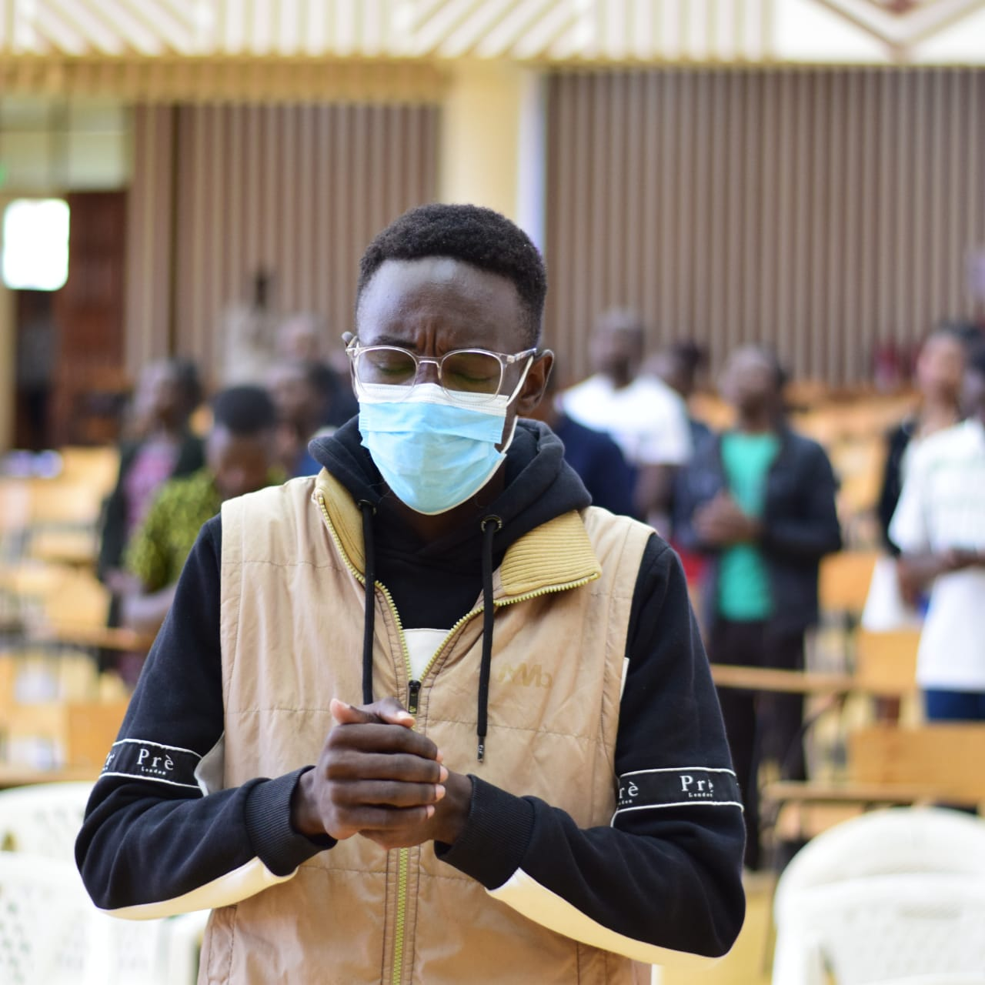


Pursuing Higher Education
Education has always been a priority for me. I was determined to pursue higher education and gain knowledge that would help me make a positive impact on the world.
University Journey
I earned a degree in [insert field of study] from [insert university name] , which opened doors to new opportunities and a broader understanding of the world.
Focus on Learning
My time in university was a period of intense learning and personal growth, where I developed critical thinking skills and expanded my knowledge base.

Slide 6
Discovering My Passion for Public Service
My passion for public service was ignited during my university years. Witnessing firsthand the needs of my community inspired me to dedicate myself to making a difference.
Community Involvement
Finding Purpose
I volunteered with local organizations, providing support and resources to those in need. These experiences deepened my understanding of social issues and fueled my desire to help.
My desire to make a positive contribution to society became a driving force in my life, leading me to pursue a career in public service.

Slide 7
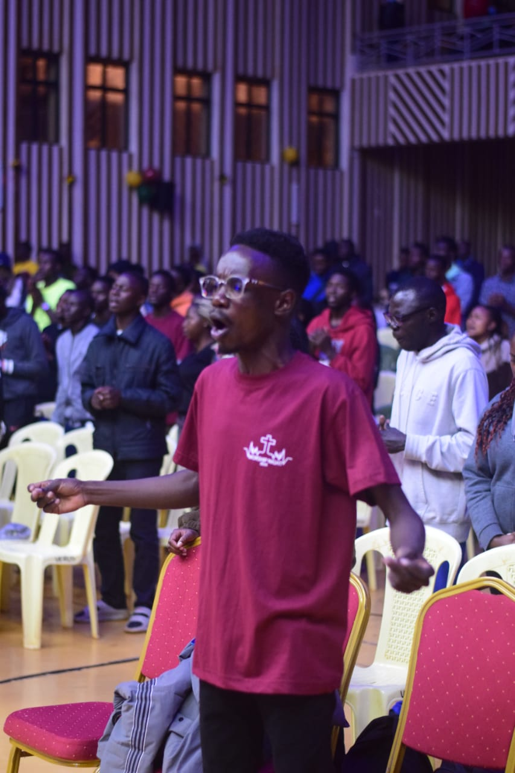
Giving Back to My Community
I've dedicated my career to serving the community that has given me so much. My work in public service has been fulfilling and has allowed me to directly impact the lives of others.
Initiatives
Impact
[Insert specific initiatives]
[Insert positive outcomes]
[Insert specific initiatives]
[Insert positive outcomes]

Slide 8
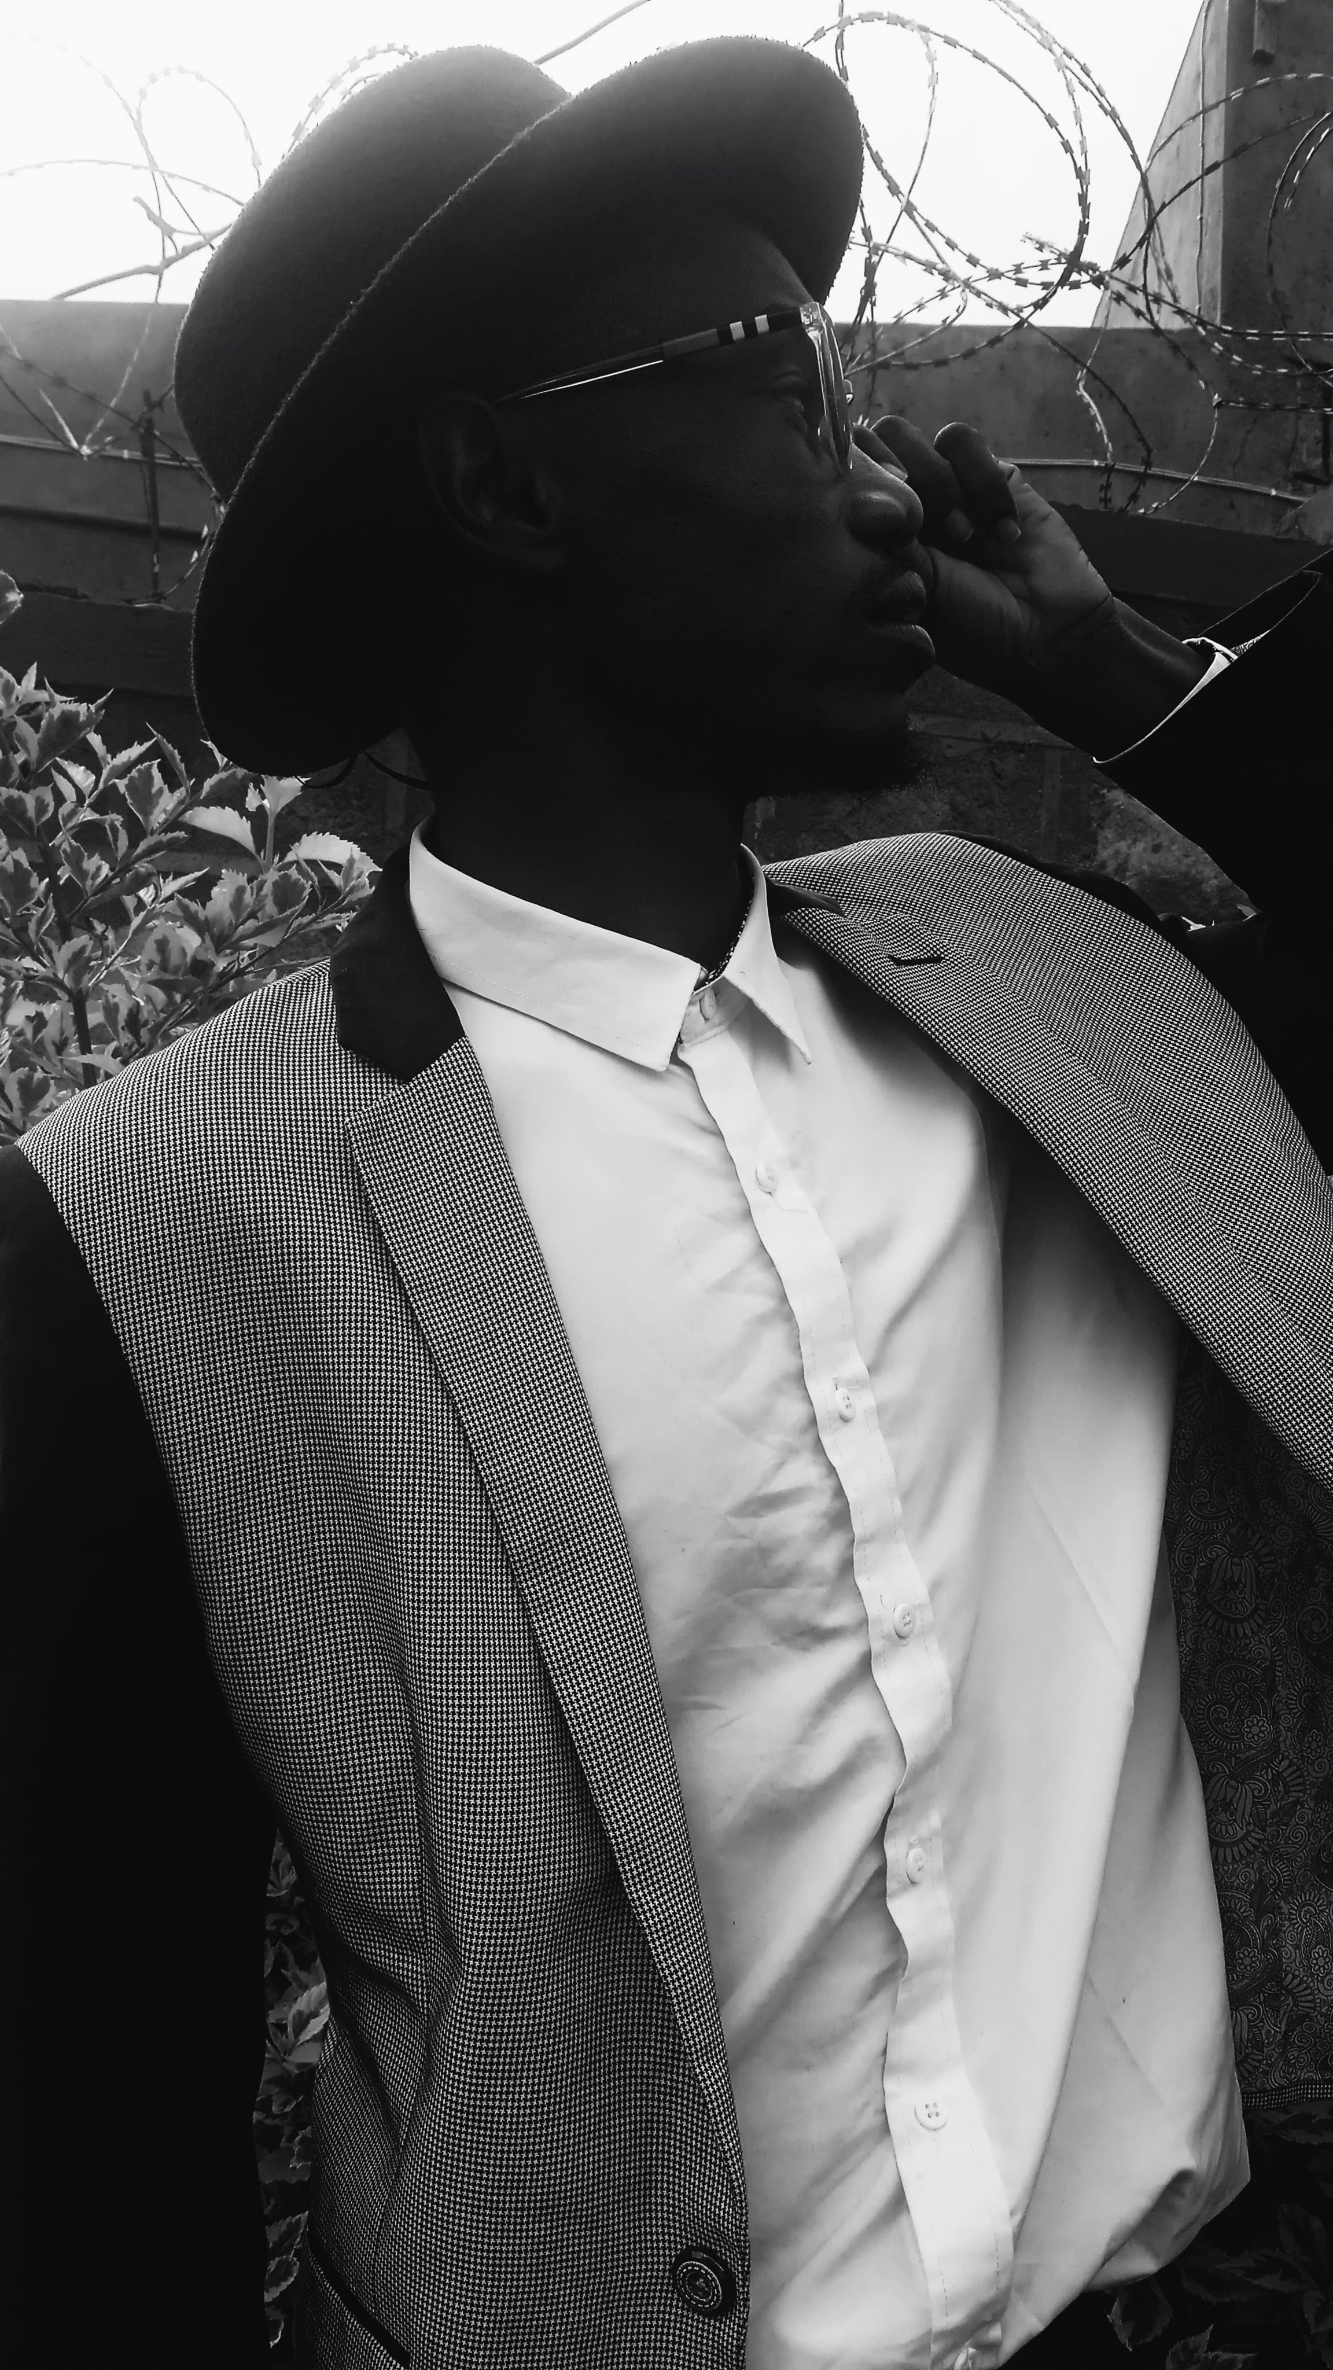



Looking Towards the Future
I'm grateful for the journey that has brought me to where I am today. I look forward to continuing to learn, grow, and make a positive contribution to the world around me.
New Goals
I'm excited to set new goals and pursue opportunities that will allow me to make a greater impact.
Personal Growth
I'm committed to continuing to learn and develop my skills to become an even more effective leader and advocate for positive change.
Community Impact
I'm passionate about working with others to create a better future for everyone.

